Slide 1

▣
PUJ-fungi repository · commit 28dad14
⚗
antiSMASH 8.0.4 + Funannotate
re-audited 2026-09-08
✓
Two Fungi, One Question.
Field Ally or Toxigenic Risk?
AF-PUJ (Aspergillus flavus) vs. TA-PUJ (Trichoderma asperellum) — agricultural biocontrol genomic review, AGRI-BIOCONTROL-GENOMIC-SCRUTINY V6
95
4
~230
BGC regions inventoried & verified
Critical audit findings resolved in V6
machine checks re-run on byte-verified data
Recap for colleague review · generated from WhyAdr/PUJ-fungi payloads

Slide 2


The Two Isolates at a Glance
TA-PUJ · Trichoderma asperellum
AF-PUJ · Aspergillus flavus
BIOCONTROL CANDIDATE
TOXIGENIC — CLOSED-VESSEL USE ONLY
ASSEMBLY
20.29 Mb · 1,376 contigs (largest 62.7 kb) · GC 48.68%
ASSEMBLY
36.79 Mb · 97 scaffolds (largest 2.40 Mb) · GC 48.15%
GENES
5,229 CDS · 134 tRNA
GENES
9,792 CDS · 259 tRNA
BGC REGIONS
21 → 8 with MIBiG matches + 13 orphan
BGC REGIONS
74 → 34 with MIBiG matches + 40 orphan
KEY TRAITS
ACC deaminase (TA:PUJ_004816), 14 GH18 chitinases, 7 GH75 chitosanases, FET3–FTR1 iron-scavenging dyad
KEY TRAITS
complete PHO phosphate regulon, 154 P450s, 24 GSTs, aerobactin-like NIS siderophore
⚠
Draft assembly ≈55–60% of expected 33–40 Mb — absence claims are lower bounds, not proof (C1)
⊗
5 confirmed toxigenic BGCs — aflatoxin, CPA, aspirochlorine, aspergillic acid, 3-NPA

Slide 3
V5 → V6 — What the Re-Audit Found
✓
IN GOOD SHAPE
24/24
95/95
95%+
audit findings addressed in the V6 change log
BGC inventory rows re-verified exactly — lengths, scores, gene hits, identity ranges
of ~230 machine checks pass (Biopython + raw /db_xref parsing on byte-verified payloads)
All four Critical findings are genuinely resolved
✓
C1
— TA assembly-completeness caveat added; absence claims downgraded to lower bounds
✓
C2
— TA mycotoxin verdict re-tiered: 13 orphan BGCs + incomplete assembly → LC-MS/MS screen mandated
✓
C3
— 5,098 cross-genome locus-tag collisions fixed via TA:/AF: prefixes throughout
✓
C4
— 3-nitropropanoic acid BGC (703_c2) added as 5th toxigenic cluster
⊗
Residual: 4 Major + 8 Minor one-line errors (wrong locus tags / stale numbers) — none alters a conclusion. Exact fixes on slide 8.

Slide 4
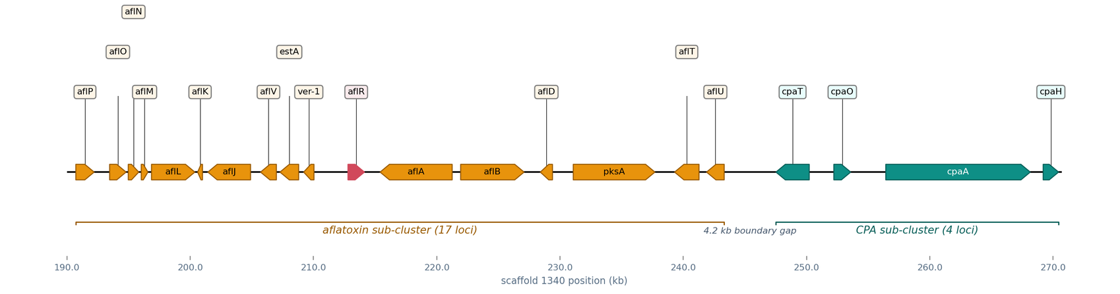
The Key Gene Cluster — Aflatoxin + CPA Super-Cluster
Scaffold 1340 · 21 loci across 79.7 kb · rendered with dna_features_viewer (the plotting engine behind gbparse neighborhood --visualize)
aflatoxin sub-cluster (17 loci, aflP→aflU)
CPA sub-cluster (cpaT/cpaO/cpaA/cpaH)
aflR — Zn(II)2Cys6 master regulator
94% / 97%
4.2 kb
28–32 kb
AflR / PksA identity to BGC0000007.3 (aflatoxin cluster, 11 genes, score 16,946)
intergenic boundary between aflatoxin and CPA sub-clusters
deletion in commercial atoxigenic strains (Aflasafe, NRRL 21882) — ABSENT in AF-PUJ: the full cluster is present
antiSMASH region 1340_c1 = 201,074..280,200 (79,127 bp) · evidence tier T2

Slide 5
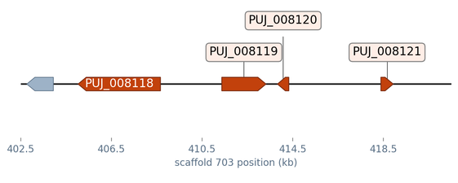
Biosafety Gate — Five Confirmed Toxigenic BGCs in AF-PUJ
TOXIN
MIBIG / RULE
GENES
SCORE
IDENTITY
Newest addition — 3-NPA (C4)
Aflatoxin B1/G1
11
BGC0000007.3
16,946
51–97%
IARC Group 1
4
Ca²⁺-ATPase inhibitor
Cyclopiazonic acid
BGC0000977.4
9,573
90–97%
19
thiol-reactive cytotoxin
Aspirochlorine (ETP)
BGC0001123.5
17,383
94–100%
6
Scaffold 703 · 403.9–421.8 kb · PUJ_008118–008121 — missed in V5, now in the LC-MS/MS panel
Aspergillic acid
BGC0001516.5
6,227
75–100%
hepatotoxin
3-Nitropropanoic acid
rule (NpaA & NpaB)
4
region 17,956 bp
rule match
mitochondrial poison
⊘
AF-PUJ is NOT an atoxigenic biocontrol strain. No live field inoculation — closed-vessel fermentation or sterile bioremediation matrices only.

Slide 6
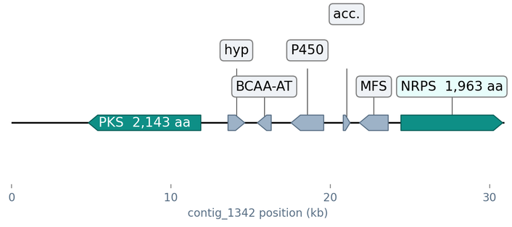
TA-PUJ — Biocontrol Profile (and Its Caveats)
✿
Plant growth & stress relief
✦
Mycoparasitism arsenal
✓
ACC deaminase Tas-acdS (TA:PUJ_004816) — EC 3.5.99.7, IPR005965-verified, the ethylene-rescue enzyme
14
7
GH18 chitinases
GH75 chitosanases
IAA auxin synthesis: T3 literature inference only — Salkowski + LC-MS/MS required (no YUCCA / ipdC found)
16
FET3–FTR1
⊗
S8 subtilisin proteases
RIA dyad (contig_623)
⚗
Secondary metabolites (21 BGC regions)
Leucinostatin-like BGC · contig_1342
enniatin-like ionophore — contig_1710, 54% to BGC0000342.4
leucinostatin-like insecticidal depsipeptide — contig_1342, 52–86% to BGC0001358.4
metachelin siderophore — contig_1419 (scaffold-edge truncation)
8 of 21 regions have MIBiG matches
hybrid PKS (2,143 aa) + NRPS (1,963 aa) + P450 + MFS — classic insecticidal depsipeptide architecture
?
13 of 21 BGC regions are orphans — uncharacterized metabolic potential
⚠
Assembly ≈55–60% complete — no peptaibol megasynthetase ≥6,000 aa assembled, but collapse across 1,376 contigs cannot prove absence (Aib 85-Da neutral-loss MS/MS mandated)

Slide 7
Deployment Verdict
TA-PUJ
field bio-inoculant
CANDIDATE
AF-PUJ
closed-vessel industrial strain
ONLY
→
→
✿
direct soil & seed inoculation, mycoparasitism + stress relief profile intact
✦
enzyme fermentations (cellulases, amylases, phosphatases) with detoxified filtrate
✓
gate: Tier-5 metabolite screening before any field pilot
✦
sterile, non-food bioremediation matrices
⚒
re-sequencing / long-read scaffolding + BUSCO (hypocreales_odb10) to close the completeness gap
⊘
never live in open agricultural soils — 5 toxigenic BGCs, intact aflatoxin/CPA cluster
⚗
5-tier wet-lab validation
T1
T2
T3
T4
T5
dual-culture confrontation (F. oxysporum / R. solani)
→
ACC deaminase DF-3mM assay (α-ketobutyrate @540 nm)
→
CAS siderophore halo (72 h)
→
Pikovskaya phosphate SI
→
LC-MS/MS 5-toxin panel + Trichoderma metabolites (peptaibols Aib-85, harzianum acid, trichothecenes)

Slide 8
Re-Audit Residuals — 12 One-Line Fixes Before V6.1
none alters a conclusion; all verified against the payloads
4
Major
8
Minor
R5
region 1340_c1 end = 280,200 (§7B length 79,127 is right)
R1
§8.2 nitrilase list — replace PUJ_000676/002829/003006/003664 with PUJ_001222 / 002797 / 003129 / 004143 (only 002797 carries EC 3.5.5.1)
R6
§9.6 stale 23.9 Mb / 6,009 → 20.29 Mb / 5,229
R7
re-tier FET3 / PHO5 / NIS ECs to T3 (not in GBK)
R2
§1 BCAA row — AF:PUJ_002717 is Dicer-like dcl1; real EC 2.6.1.42 hits: TA 3 (003177/003357/004941), AF 4 (001094/001443/008295/009285)
R8
m2 glucanase locus = TA:PUJ_002322, not 002476
R9
§8.1 AbT1 = BGC0000307.4 · 2,072 · 52% (as §3.A.7)
R3
§2.B.6 — aspirochlorine GST is AF:PUJ_004908 (246 aa), not PUJ_004910 (422 aa dipeptidase)
R10
glucanase products TA 8 / AF 4; AF phosphatase-by-product = 112
R11
§7 type column simplified; AF coords are region-local
R4
m4 — scaffold 1340 length is 280,200 bp, not 135,160
R12
PUJ_000117 4-module claim is inference → T3
Full details: reaudit-v6-verification-report.md — evidence JSONs in data/, scripts in scripts/

Slide 9
Trust the directory.
Doubt the deletions.
Screen before you sow.
TA-PUJ
AF-PUJ
V6
promising field candidate, pending metabolite screen + re-assembly
toxigenic; industrial closed-vessel value only
12
V6.1
audit-verified core, residual one-liners →
Data: AF gbk d3fb74bf367092e6 · 83,318,907 B — TA in c07f6c6e379fec38 · 45,029,346 B — TA antiSMASH b27db6f44d8fe3e7 · 44,880,695 B
Tools: Funannotate 1.8.17 · antiSMASH 8.0.4 · MIBiG · Biopython 1.84 · gbparse 0.8.1 + dna_features_viewer 3.1.5
PUJ-fungi · Mbak Pujiati research program · recap generated 2026-09-08

